Slide 1
Soak Tester Apparatus & System
Neuralink, US 2023/01688317, 6/1/2023
3/31/2024

Slide 2
Outline
Goal: Soak tester apparatus for testing electrical characteristics of an implantable enclosure (to ensure electrical integrity)
Embodiments:
Soak Tester Apparatus
Implantable Closure being Soaked
Multiple soak tester apparatuses
Impedence engine
Multiplexer system
Histogram of Impedances
Heat Map of Impedance

Slide 3
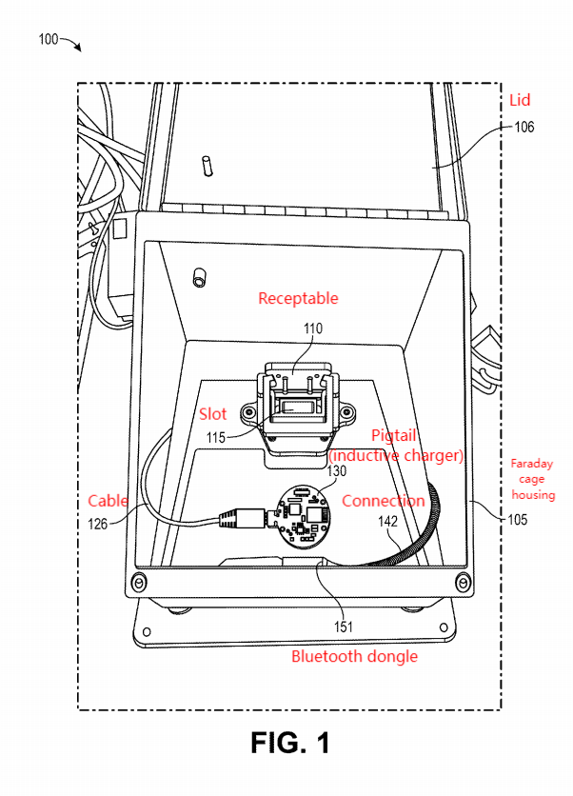
Soak Tester Apparatus

Slide 4
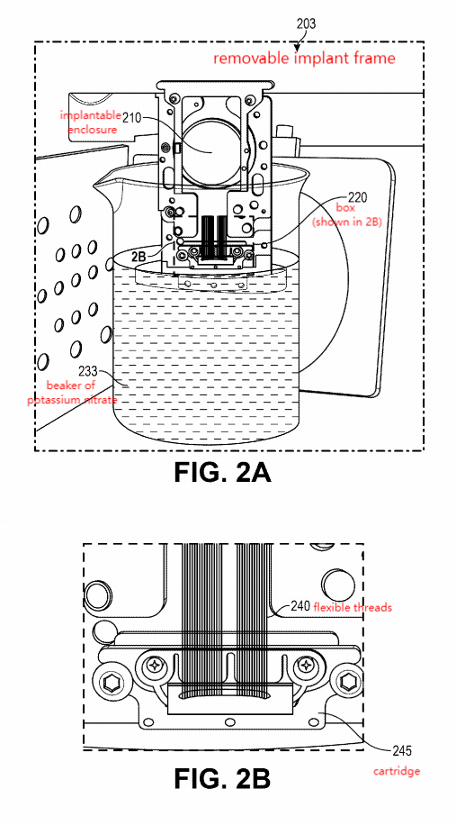
Implantable Enclosure Being Soaked
Soak into potassium nitrate (KNO3)
Dispose within removable implant frame after surgical insertion
Bottom 5mm of threads inside solution

Slide 5
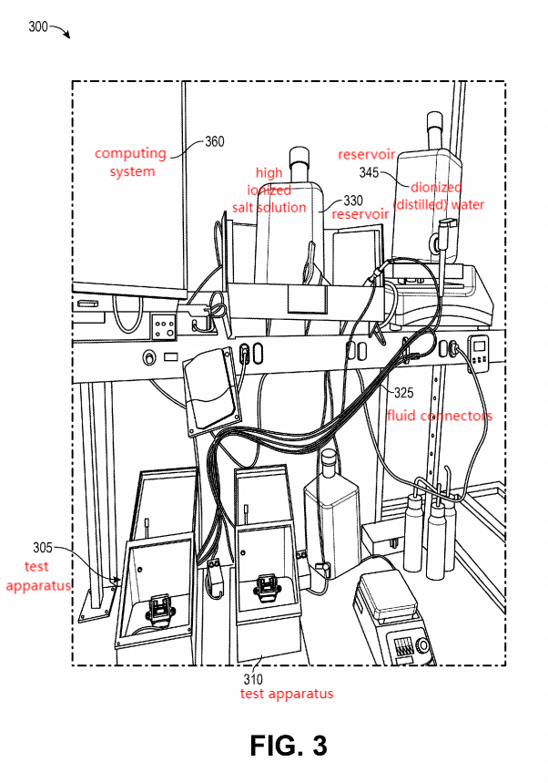
Multiple Soak Tester Apparatuses
2 soak tester apparatuses shown, each with a reservoir
1 to hold high-ionized salt solution (e.g., potassium nitrate KNO3)
1 to hold deionized (DI) or distilled water - wash salt away
Computing system - operation controls + program + monitor tester

Slide 6
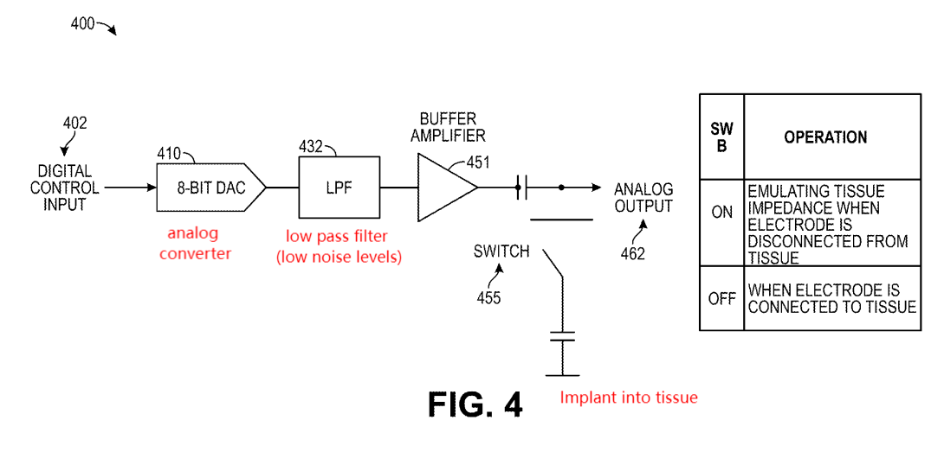
Impedance Engine *****

Slide 7
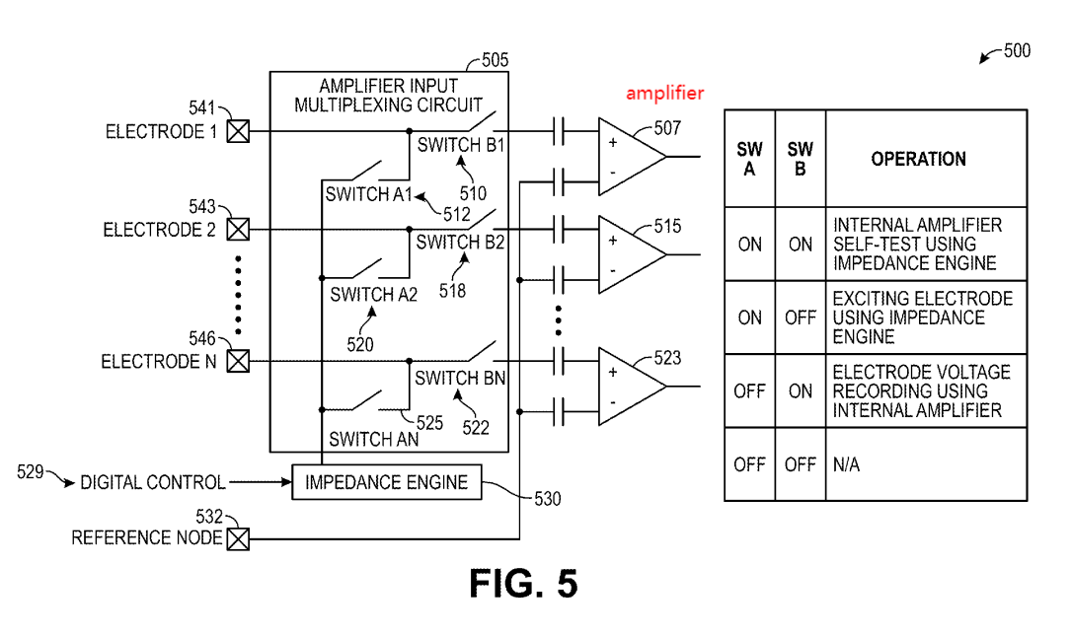
Multiplexer System
Uses 2-point impedance (electrode vs reference node)
Reference node reading differs greatly from electrode - FAILURE

Slide 8
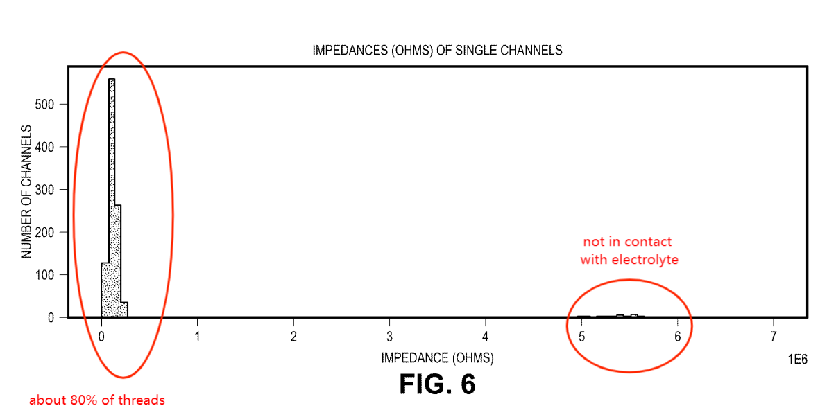
Histogram of 1024 Impedences Measured ***
1024 Channels
64 threads of 16 electrodes each
49 - 52 threads (about 80%) with proper impedance - good for surgery

Slide 9
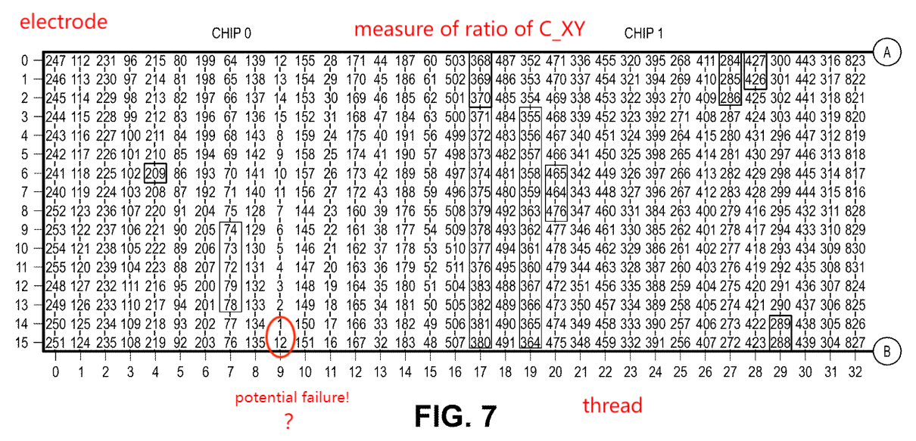
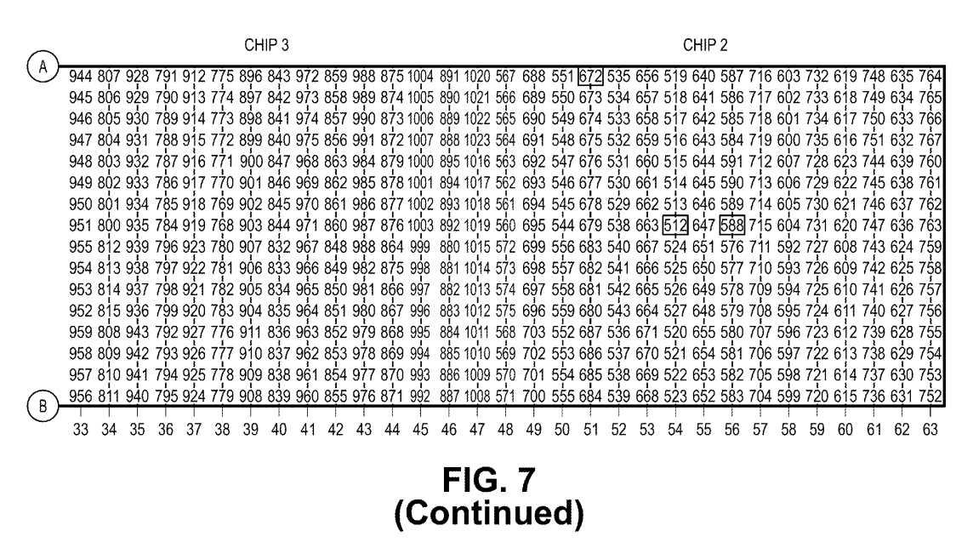
Heat Map of Impedence *******
C_XY = cross-coupling ratio between channel X (working electrode) & Y (reference node)
Amplitude of oscillation seen in channel X vs Y, while running waveform on channel Y (reference)
C_XY for neighboring electrodes - useful for failure rate
Boxed - all 1024 channels measured & evaluated

